Slide 1
OS Fundamentals & Networking

Slide 2
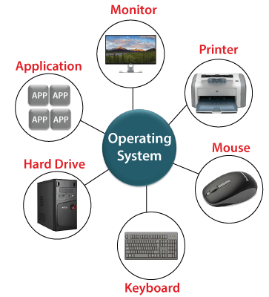
Operating System Overview:

Slide 3
OS is intermediary between the computer user and the computer hardware as it provides a standard user interface that you see on your computer screen after you switch on your computer.
So, although the operating system is itself a program or software, it allows users to run other programs or applications on the system.

Slide 4
Functions of Operating System:
Resource/ hardware management
Process Management
Storage Management (HD)
Memory Management (RAM)
I/O Management
Security & Privacy

Slide 5
Types of Operating System:
Batch Operating System
Multiprogramming Operating System
Multitasking Operating System
Distributed(multiprocess) Operating System
Network Operating System:
Real-Time Operating System:

Slide 6
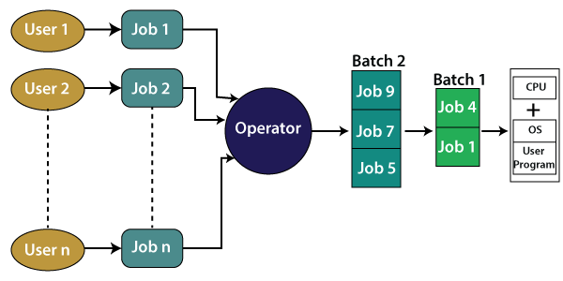
1) Batch OS:-

Slide 7
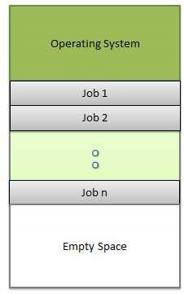
2)Multiprogramming OS:

Slide 8
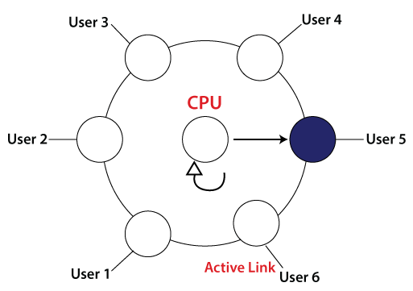
3) Multitasking OS:- Time Quontum 2sec.

Slide 9
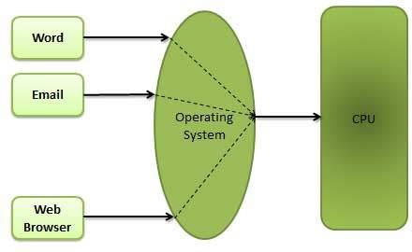
Ex:

Slide 10
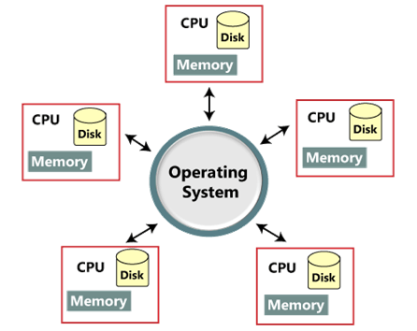
4) Distributed OS:-

Slide 11
CPU1
CPU2
CPU3
P1
P2
P3
P4

Slide 12
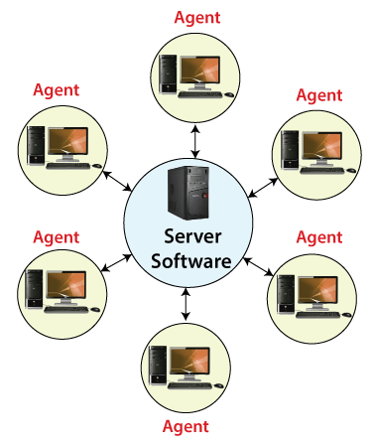
4) Network OS:-

Slide 13
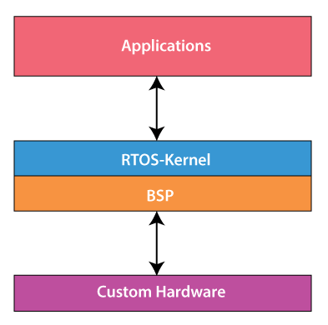
5) Real Time OS:-

Slide 14
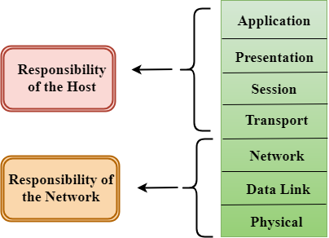
OSI Model: Ref. model

Slide 15
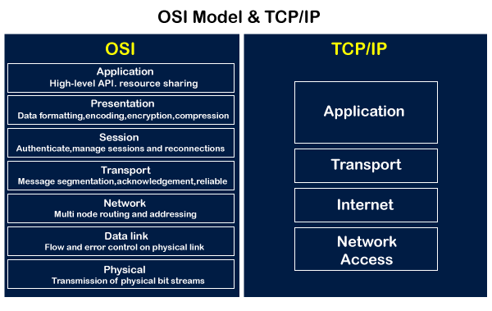
OSI vs TCP/IP

Slide 16
Computer Network:
A computer network is a set of devices connected through links. A node can be computer, printer, or any other device capable of sending or receiving the data. The links connecting the nodes are known as communication channels.

Slide 17
Types:
LAN(Local Area Network)
MAN(Metropolitan Area Network)
WAN(Wide Area Network)

Slide 18
Network Devices:
Hub.
Repeater.
Bridge.
Switch.
Router.
Gateway.

Slide 19
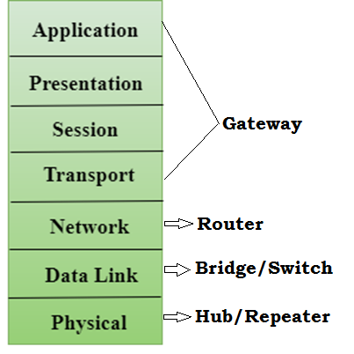

Slide 20
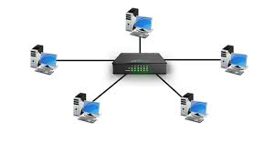
HUB:

Slide 21
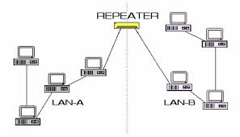
Repeater:

Slide 22
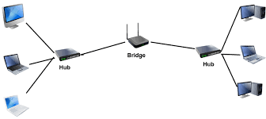
Bridge:

Slide 23
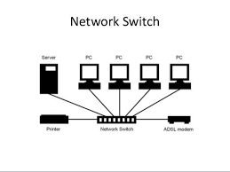
Switch:

Slide 24
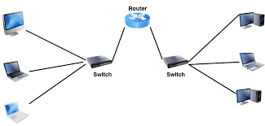
Router:

Slide 25
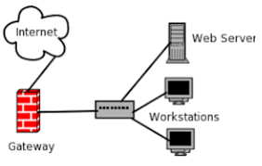
Gateway:

Slide 26
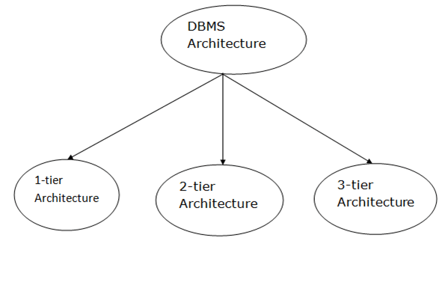
DBMS Architecture

Slide 27
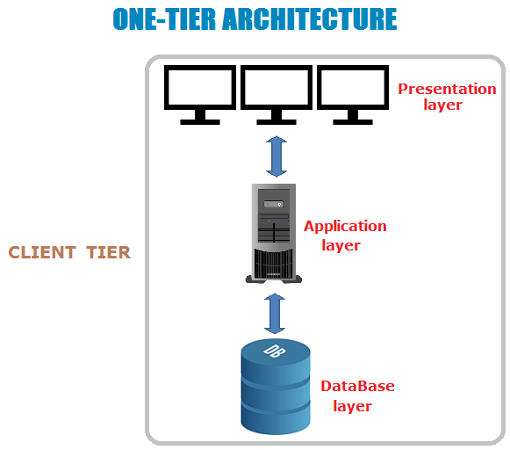

Slide 28
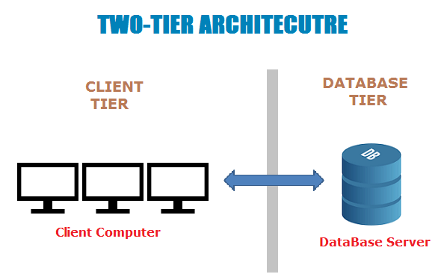

Slide 29
